Slide 1


St. Francis Institute of Technology Department of Computer Engineering Mini Project – Sem VI
Book Recognition System
Group Members
Name of Student | Class-Roll No.
Chelamallu Vinutha | TE CMPN A-13
Melita Coutinho | TE CMPN A-15
Jenny D’cruz | TE CMPN A-20
Notes:
‹#›

Slide 2
Content
Abstract
Introduction
Literature Review
Problem Statement
Work Flow of the system
Working Demo
Result Analysis
Conclusion
References
4/20/2020
Book Cover Recognition
‹#›

Slide 3
Abstract
Machine learning algorithms work with a large amount of data, explore and search for a model that will work out what the programmers have set out to achieve.
Optical character recognition is the machine replication of human reading and has been the subject of intensive research for more than three decades.
We use optical character recognition technique to detect the text in the images.
4/20/2020
Book Cover Recognition
‹#›

Slide 4
Introduction
In this project we applied Optical Character Recognition (OCR) to images using Tesseract and Python.
This application detects text of different font styles and sizes to help reading text off of a cover.
For instance this can be applied in various applications such as on images uploaded on ecommerce websites to read text which makes random book recognition easier while shopping online.
4/20/2020
Book Cover Recognition
‹#›

Slide 5
Literature Review
Akhil s Nair,”Overview of Tesseract OCR engine”
Gives an overview about how Tesseract OCR works.
Xiao Yang, Dafang He, Wenyi Huang, Alexander Ororbia, Zihan Zhou, Daniel Kifer, C. Lee Giles, "Smart Library: Identifying Books on Library Shelves Using Supervised Deep Learning for Scene Text Reading,"
In large libraries it is difficult to find a particular book from the book shelves.
Hence, the author suggests an alternative to find the book by a deep neural network-based system to automatically localize, recognize and index text on bookshelves images.
4/20/2020
Book Cover Recognition
‹#›

Slide 6
Literature Review
Linfeng Yang and Xinyu Shen “Book cover recognition”
The author proposes to find the cost, reviews and more information of the book just by uploading the image which will help a new reader to decide whether to buy a particular book or not.
The author uses OCR techniques to detect the name of the book and the author.
Then uses these as keywords to find other details in search engines.
4/20/2020
Book Cover Recognition
‹#›

Slide 7
Problem Statement
Image recognition is used to perform a large number of machine-based visual tasks, such as labeling the content of images with meta-tags.
Our application helps read and display the details on a book cover by just uploading an image of the book cover.
This application will detect capital letters, small letters, and special characters as well. Thus making random book recognition online easier.
The book recognition system allows you to detect the characters off of the cover of a book i.e. the name of the book and the authors name. Additionally it also detects other text written on the cover of the book.
4/20/2020
Book Cover Recognition
‹#›

Slide 8
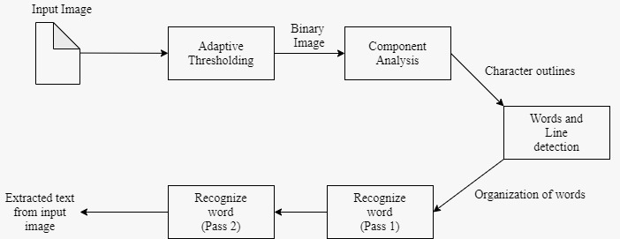
Work Flow
4/20/2020
Book Cover Recognition
‹#›
Notes:
Architecture
The pipeline of Tesseract OCR engine is given in fig1.
The first step is Adaptive Thresholding, which converts the image into a
binary version using Otsu’s method . The next step is page layout analysis,
which is used to extract the text blocks within the document. In the next stage the baselines of each line are detected and the text is divided into words using definite spaces and fuzzy spaces.
In the next step, the character outlines are extracted from the words. Recognition of text is then started as two-pass process. In the first pass,word recognition is done using the static classifier. Each word passed satisfactory is passed to an adaptive classifier as training data [4]. A second pass is run
over the page, using the newly learned adaptive classifier in which words that were not recognized well enough are recognized again.

Slide 9
Adaptive thresholding
Adaptive thresholding typically takes a grayscale or color image as input and, in the simplest implementation, outputs a binary image representing the segmentation.
For each pixel in the image, a threshold has to be calculated. If the pixel value is below the threshold it is set to the background value, otherwise it assumes the foreground value.
4/20/2020
Book Cover Recognition
‹#›

Slide 10
Preprocessing Algorithm
procedure AdaptiveThreshold(in,out,w,h):
for i = 0 to w do
sum ← 0
for j = 0 to h do
sum ← sum + in[i,j]
if i = 0 then
intImg[i,j] ← sum
else
intImg[i,j] ← intImg[i - 1,j] + sum
end if
end for
end for
4/20/2020
Book Cover Recognition
‹#›

Slide 11
Preprocessing Algorithm
for i = 0 to w do
for j = 0 to h do
x1← i - s/2 {border checking is not shown}
x2 ← i + s/2
y1 ← j - s/2
y2 ← j + s/2
count ← (x2 - x1) x (y2 - y1)
sum ← intImg [x2,y2] - intImg[x2, y1 - 1] - intImg[x1 - 1, y2] + intImg[x1 - 1, y1 - 1]
if(in[i,j] x count) < = (sum x (100 - t)/100) then
out[i, j] ← 0
else
out[i, j] ← 255
end if
end for
end for
4/20/2020
Book Cover Recognition
‹#›

Slide 12
Component Analysis
Component Analysis is the second step of OCR,
divides an image into areas of text and non-text
Splits multi-column text into columns
4/20/2020
Book Cover Recognition
‹#›

Slide 13
Word and line Detection
Word finding was done by organizing text lines into blobs, and the lines and regions are analyzed for fixed pitch or proportional text. Text lines are broken into words differently according to the kind of character spacing. Recognition then proceeds as a two-pass process.
4/20/2020
Book Cover Recognition
‹#›

Slide 14
Recognizing Words (Pass 1 and 2)
In the first pass, an attempt is made to recognize each word in turn. Each word that is satisfactory is passed to an adaptive classifier as training data.
In the second the adaptive classifier gets a chance to more accurately recognize text lower down the page.
4/20/2020
Book Cover Recognition
‹#›

Slide 15
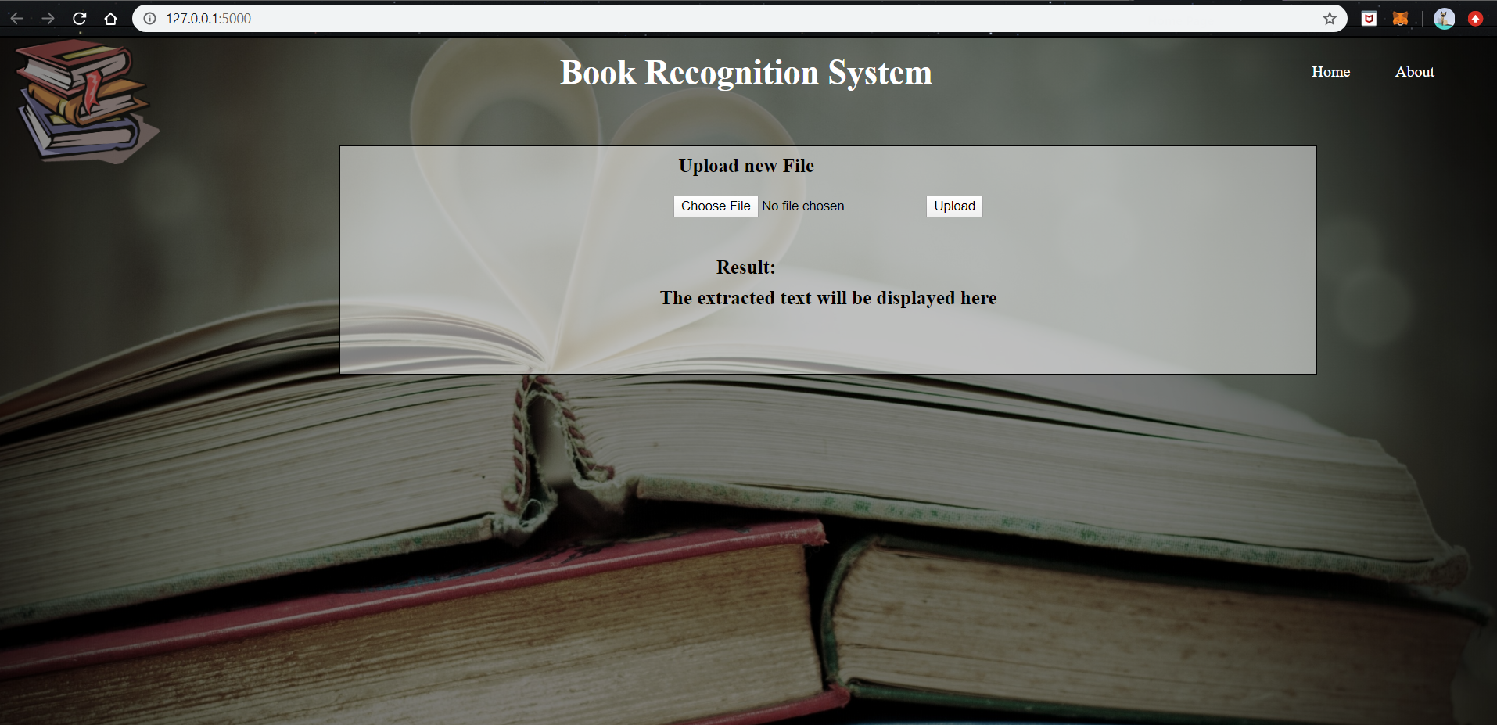
Working demo
The front end
4/20/2020
Book Cover Recognition
‹#›

Slide 16
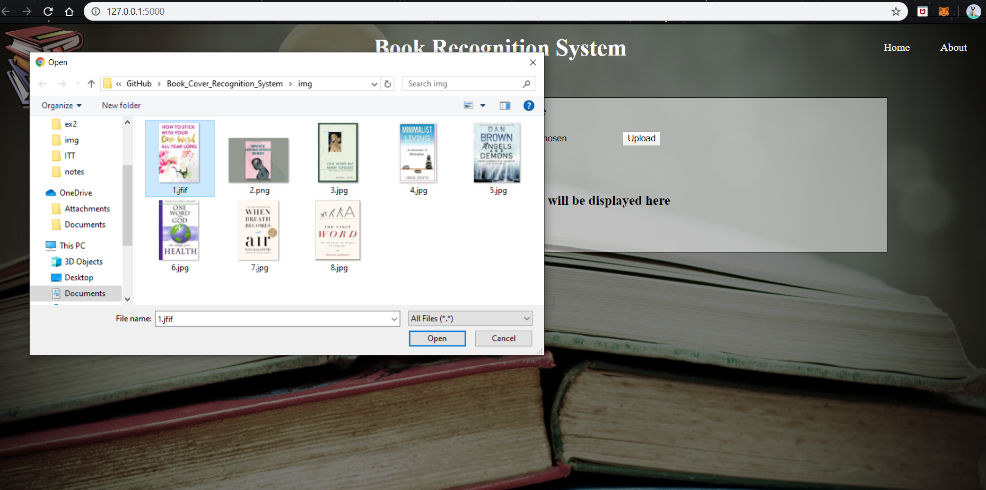
Working demo
Selecting an image
4/20/2020
Book Cover Recognition
‹#›

Slide 17
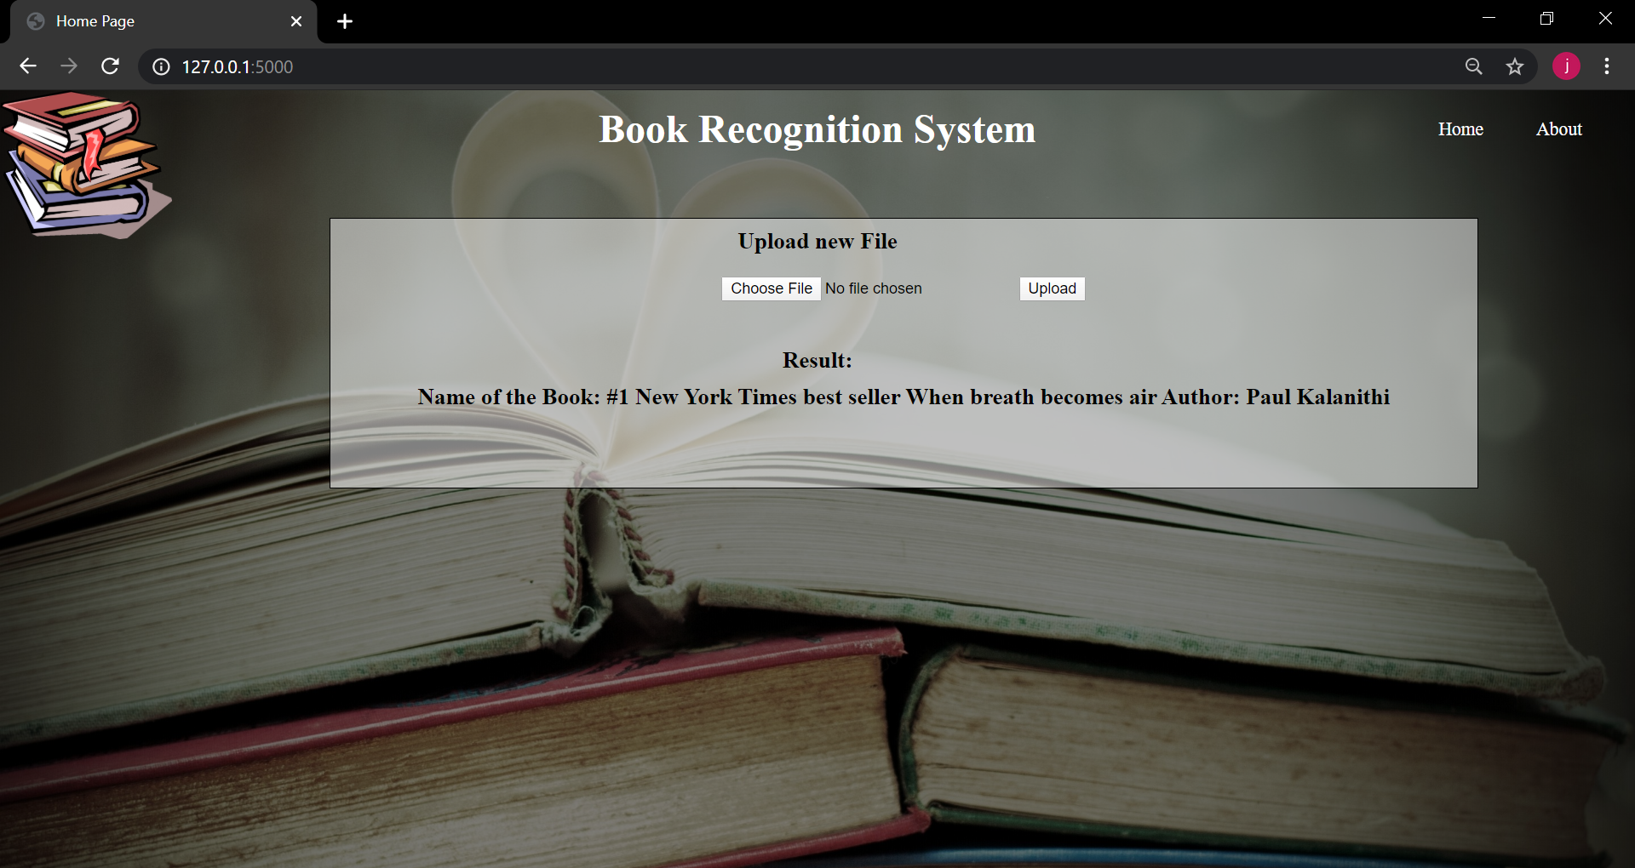
Working demo
Display of the text on the book cover
4/20/2020
Book Cover Recognition
‹#›

Slide 18
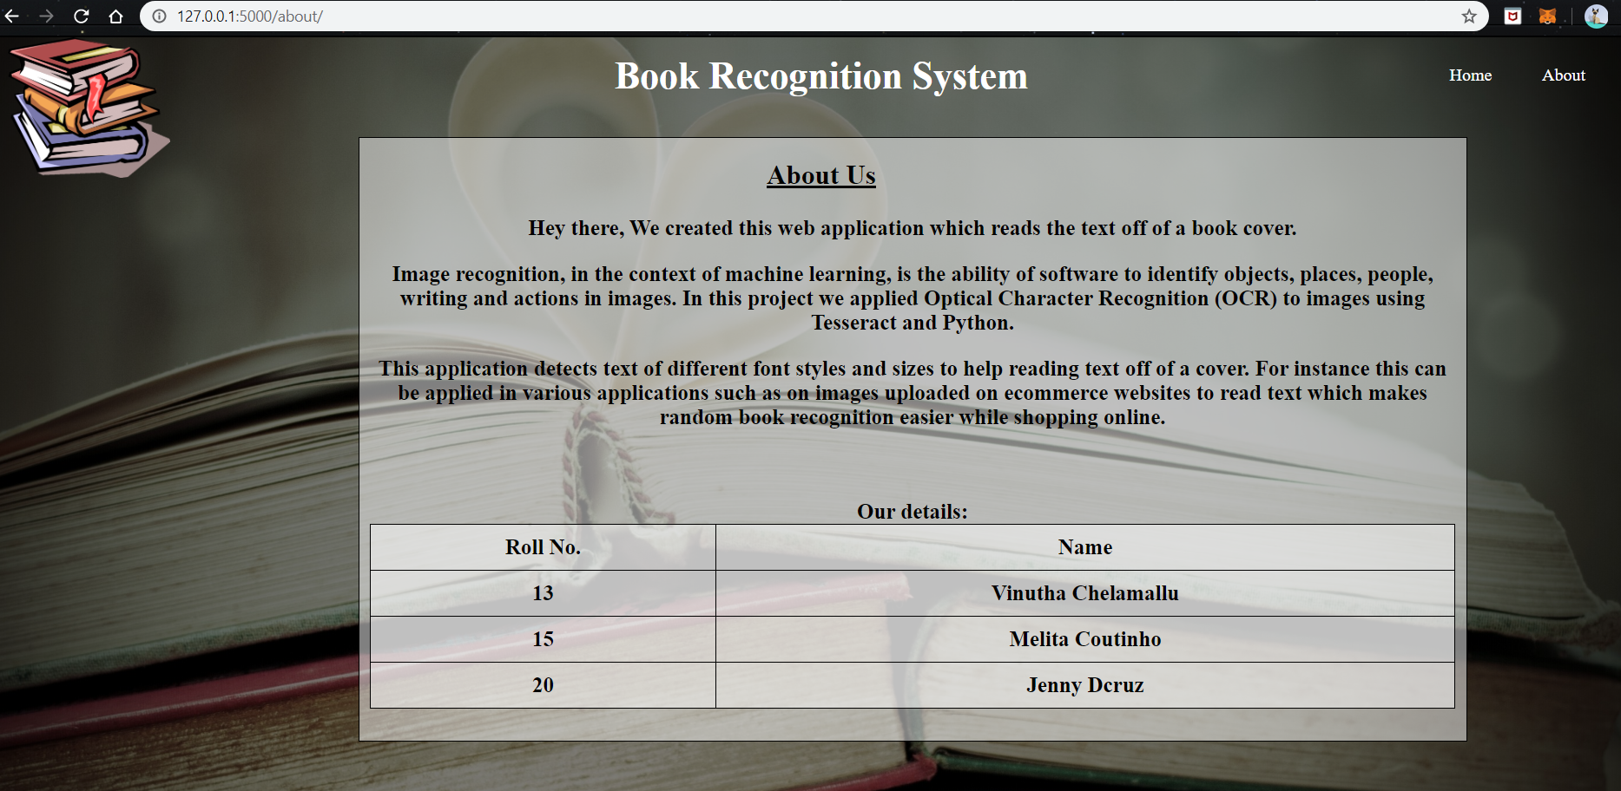
Working demo
About Us Page
4/20/2020
Book Cover Recognition
‹#›

Slide 19
Results Analysis
We used Logistic Regression, Random Forest and Support Machine Vector to find the accuracy of our model.
Confusion Matrix
Name of the Algorithm | Accuracy Obtained (%)
Random Forest | 87.5
Logistic Regression | 81.8
Support Vector Machine | 54.54
Predicated Efficiency Actual Efficiency | Text Detected Incorrectly | Text Detected Correctly
Text Detected Incorrectly | 5 | 1
Text Detected Correctly | 0 | 2
4/20/2020
Book Cover Recognition
‹#›

Slide 20
Conclusion
The main requirement of book recognition system was tesseract OCR which detected the text in the image.
By using the book recognition we make it easier for the reader to know the name of the author and the book easily. This project will also help to find details of a book over the Internet.
Further this project can we further be used to know the synopsis of the book just by scanning the book cover.
4/20/2020
Book Cover Recognition
‹#›

Slide 21
References
[1] Akhil s Nair,”Overview of Tesseract OCR engine”,National Institute of Technology Calicut
[2]Xiao Yang, Dafang He, Wenyi Huang, Alexander Ororbia, Zihan Zhou, Daniel Kifer, C. Lee Giles, "Smart Library: Identifying Books on Library Shelves Using Supervised Deep Learning for Scene Text Reading," ACM/IEEE Joint Conference on Digital Libraries, JCDL 2017, 245-248, 2017.
[3] Linfeng Yang(linfeng@stanford.edu) , Xinyu Shen(xinyus@stanford.edu), “Book cover recognition”.
[4] Flask,Available at: https://www.fullstackpython.com/flask.html
[5] Badla, Sahil, "IMPROVING THE EFFICIENCY OF TESSERACT OCR ENGINE" (2014). Master's Projects. 420.
[6] Ray Smith , “An Overview of the Tesseract OCR Engine”in proceedings of document analysis and recognition.. icdar 2007. In IEEE Ninth International Conference, 2007.
4/20/2020
Book Cover Recognition
‹#›

Slide 22
Thank You
4/20/2020
Book Cover Recognition
‹#›

